Slide 1
Project presentation
Done by : Sanaa Khan
Dhanya K
Reka Sriniwasan

Slide 2
AGENDA
Project Title
Importance of this project
​Relevancy with the real world
​Summary​
Machine Learning
Architecture of Stroke Prediction Analysis
Data Visualization using Tableau
Accuracy Table

Slide 3
STROKE PREDICTION
USING MACHINE LEARNING (PYTHON)

Slide 4
WHAT IS STROKE?
Stroke is a medical disorder in which the blood arteries in the brain are ruptured, causing damage to the brain. When the supply of blood and other nutrients to the brain is interrupted, symptoms might develop
with early intervention, half of all strokes could be prevented by controlling modifiable risk factors in such individuals.
So Predicting and Preventing is very important for public health, so it can be reduced.

Slide 5
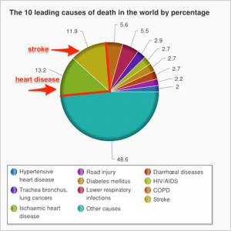
Relevancy with the real world
According to the World Health Organization (WHO) stroke is the 2nd leading cause of death globally, responsible for approximately 11% of total deaths.
The three regions with the highest estimated lifetime risk of stroke were East Asia (38.8 percent), Central Europe (31.7 percent), and Eastern Europe (31.6 percent).

Slide 6
With about three-quarters of all stroke cases occurring in low- and middle income countries
Some of them are India, Afghanistan, Bangladesh, Indonesia, Bhutan, Cambodia etc.
The World Health Organization (WHO) estimates that fifteen million people worldwide suffer from strokes each year, with one person dying every four to five minutes in the affected population.
Stroke prediction is essential and must be treated promptly to avoid irreversible damage or death.

Slide 7
SUMMARY
Healthcare Stroke dataset is used to predict whether a patient is likely to get stroke or not, based on the input parameters like gender, age, various diseases, and smoking status. Each row in the data provides relevant information about the patient.

Slide 8
ML is a branch of artificial intelligence:
Uses computing based systems to make sense out of data
Supervised Learning
For every example in the data there is always a predefined outcome
Models the relations between a set of descriptive features and a target (Fits data to a function)
2 groups of problems:
Classification
Regression
Classification
Predicts which class a given sample of data (sample of descriptive features) is part of (discrete value).
Example : Stroke prediction Analysis

Slide 9
Architecture of Stroke Prediction Analysis
Importing Libraries
Reading the CSV file
Model Building
Algorithms
Logistic Regression
KNN
SVM
Naïve Bayes
Decision Tree
Random Forest Tree
Handling missing values
Removing Outliers
Univariate analysis
Bivariate/Multi-variate Analysis
Understanding the distribution of features
Categorical Encoding:
One Hot Encoder
Feature Scaling:
MinMax Scaler
Separate Features and Target
Split Training and Testing data
Comparing the Performance of each model based on Accuracy

Slide 10
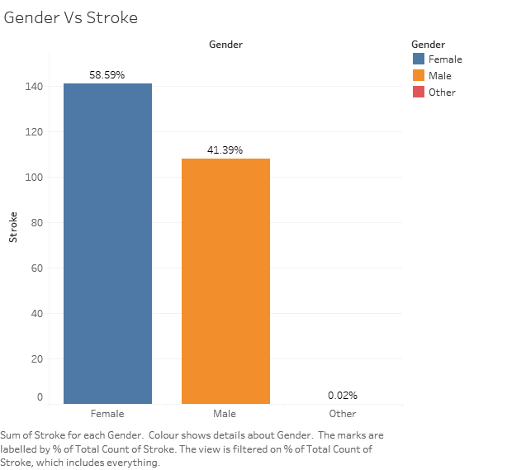
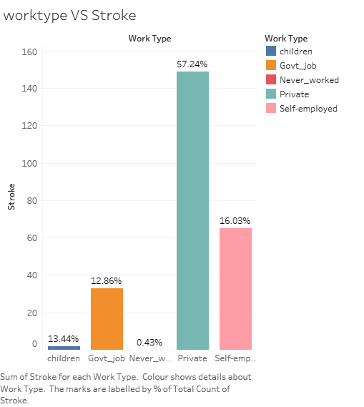

Slide 11
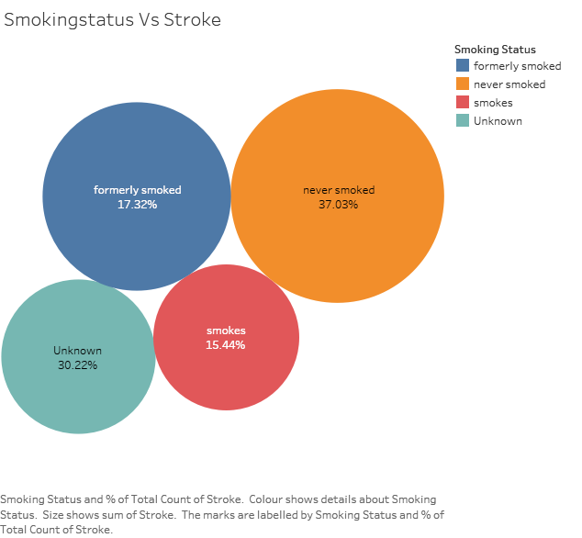
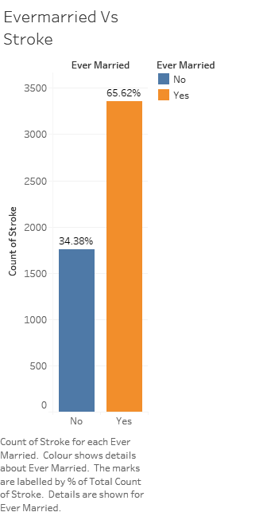

Slide 12

Comparing Accuracy of each model
MODEL NAME | TRAINING ACCURACY | TESTING ACCURACY
Logistic Regression | 95.5% | 95.3%
K-Nearest Neighbors | 95.5% | 95.3%
Support Vector Machine | 95.5% | 95.3%
Naïve Bayes | 95.4% | 95.3%
Decision Tree | 95.5% | 95.3%
Random Forest Tree | 95.2% | 95.0%
CONCLUSION
By using Supervised Algorithm the model is giving 95% accuracy,hence the stroke prediction model is neither underfitted nor overfitted

